Slide 1
برنامه دوره آموزشی مشاور شیردهی
دوشیدن شیرمادر
دکتر محمود راوری

Slide 2
Mother may choose or Need to Express Milk for a Number of Reasons
To increase the milk supply.
To stimulate Lactogenesis II (around day 2 to 5 post partum)
when breastfeeding initiation is delayed due to separation of baby and mother.
To supply milk if her baby is premature or ill or hospitalized and cannot breastfeed directly.
To prevent or relieve breast engorgement.
To have milk available if she leaves the baby with another caregiver.
To maintain or increase the milk production when ..tavel,work,hospialization, medication,..

Slide 3
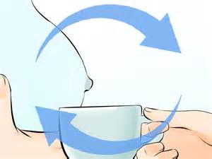
Milk Expression

Slide 4
Hand expression is the best way to express breast milk because:
Stimulation
Breast compression
Expression

Slide 5
Hand Expression of Human Milk
The most common form of milk expression throughout the world.
(Core Curriculum Lactation consultant practice 2013)
  All hospital maternity nursing staff should be trained in teaching Hand expression(AAP2009),
  Every mother should be trained in teaching hand expression .
  No equipment, not noisy, or power source (electricity) is required.
  Hands are always available.
  No cost to mother

Slide 6
Hand Expression of Human Milk
  Reason to express milk by hand
  (in addition)…
    To direct expression into the baby’s mouth
    To soften an engorged nipple/areola.
    Drains overfull milk duct to make it easier for baby to latch on.
    To elicit the milk ejection reflex prior to breastfeeding or pumping.
    If the nipple are sore or macerated and use of pump will exacerbate the tissue damage.
    When breast pumps are unaffordable.

Slide 7
Hand Expression of Human Milk
  Reason to express milk by hand (in addition)…
    Expressing colostrum.
    Hand expression can be very effective and quick when the mother is experienced.
    Some mothers prefer the skin-to-skin stimulation from hand expression rather than the feel of plastic and sound of a pump.
    Skin to skin contact is more stimulating than the feel of a plastic shield.
    Many mothers are more comfortable with manual expression of breast milk because it is more natural and the procedure is easy to learn.
    Hand expression is usually more gentle than a pump particularly if the mother’s nipple is sore.
    There is less risk of cross- infection since the mother does not use equipment that may be also handled by others.
    Milk expressed by electric breast pumping also appears to have greater bacterial contamination than milk expressed by hand.
    Manual expression is.

Slide 8
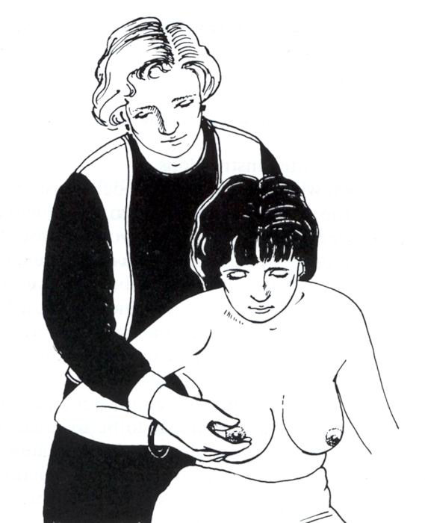
Points
It is easier to learn to hand express when the breast is soft rather than engorged and painful.
A woman should express her own breast milk.
The breasts are easily hurt if another person tries.
If you are showing a woman how to express, show her on your own body as much as possible, while she copies you.
If you need to touch her to show her exactly where to press her breast, be very gentle.

Slide 9

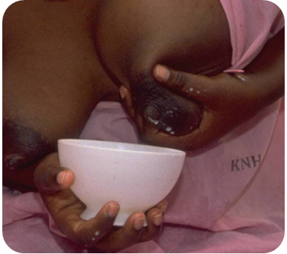
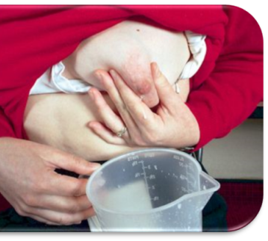
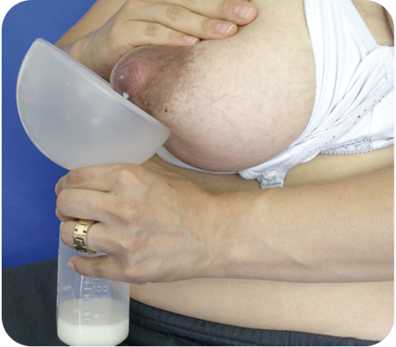
Hand Expression Techniques
Always wash hands with soap and water before expressing milk.
Milk can be expressed into any type of container ,such as: a bottle, cup, glass, jar, or bowl. It helps if the container has a wide opening.
Breast massage
Eliciting milk ejection reflex (milk release)
Expressing colostrum.

Slide 10
Why is it helpful?
(BREAST MASSAGE)
It helps a mother to relax
It encourage the milk flow
Stimulates Oxytocin release
Prolactin is released (gentle nipple stimulation)
Increase milk collection and thus milk production

Slide 11
Why is it helpful?
(BREAST MASSAGE)
It encourage a good blood flow to breast
Improves composition of human milk by increasing gross energy and lipid content
To recognize early signs of breast engorgement, or blocked ducts or lobes
Helps disperse engorged lobes and mastitis
Adds external pressure, facilitating milk flow to negative pressure area
Notes:
dr ravari
11

Slide 12
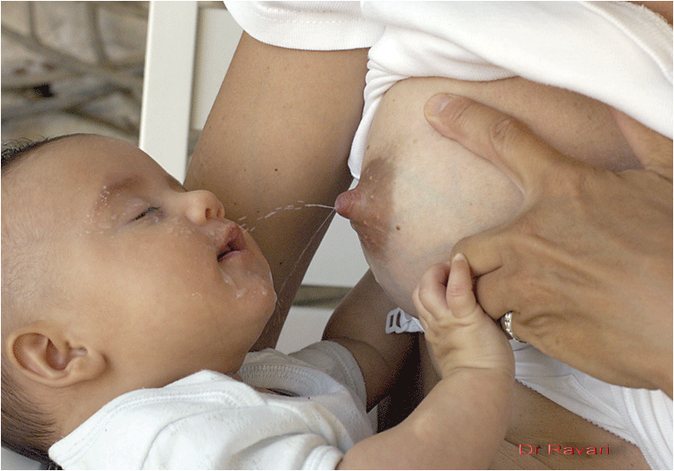

Thinking about the child or seeing them
Holding baby skin-to-skin
stimulate oxytocin release

Slide 13

Mothers who are reluctant to try hand expression!
Because previous attempts have been unsuccessful usually have had inadequate instruction. Two good strategies help this:
  First, teach hand expression when success is most likely:
    When the breast is fuelled.
    When the infant is feeding on the contra lateral breast.
  Otherwise, Encourage the milk to flow

Slide 14
If baby isn’t latching successfully by the end of the first six hours
Keep him skin to skin to stimulate his feeding reflexes and begin expressing colostrum.
Don’t use your pump quite yet, though; Hand expression usually gets more out than a pump in the beginning. It also works well if your breasts become uncomfortably full as the milk comes in because pumping can draw more fluid into your areolas, which causes swelling and makes latching difficult for your baby.

Slide 15

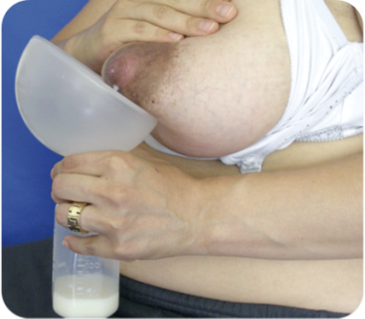
Hand Expression Techniques
Always wash hands with soap and water before expressing milk.
Milk can be expressed into any type of container ,such as: a bottle, cup, glass, jar, or bowl. It helps if the container has a wide opening.
Breast massage
Eliciting milk ejection reflex (milk release)
Expressing colostrum.

Slide 16
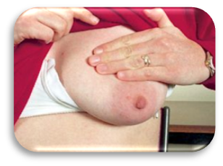
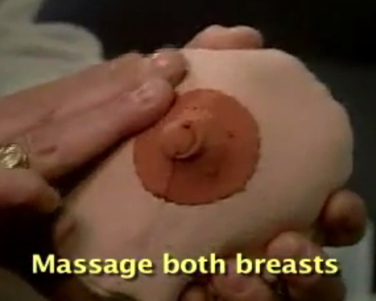
Why is it helpful?
(BREAST MASSAGE)
It helps a mother to relax
It encourage the milk flow
Stimulates Oxytocin release
Prolactin is released (gentle nipple stimulation)
Increase milk collection and thus milk production

Slide 17
Why is it helpful?
(BREAST MASSAGE)
It encourage a good blood flow to breast
Improves composition of human milk by increasing gross energy and lipid content
To recognize early signs of breast engorgement, or blocked ducts or lobes
Helps disperse engorged lobes and mastitis
Adds external pressure, facilitating milk flow to negative pressure area
Notes:
dr ravari
17

Slide 18
Thinking about the child or seeing them
Holding baby skin-to-skin
stimulate oxytocin release

Slide 19
If express to get colostrum
for her baby who is not able to suck,
The mother may be able to express into a spoon, small cup or directly into the baby’s mouth or a syringe )1 ml, 2ml or 5ml) directly from the nipple as the mother expresses it.

Slide 20
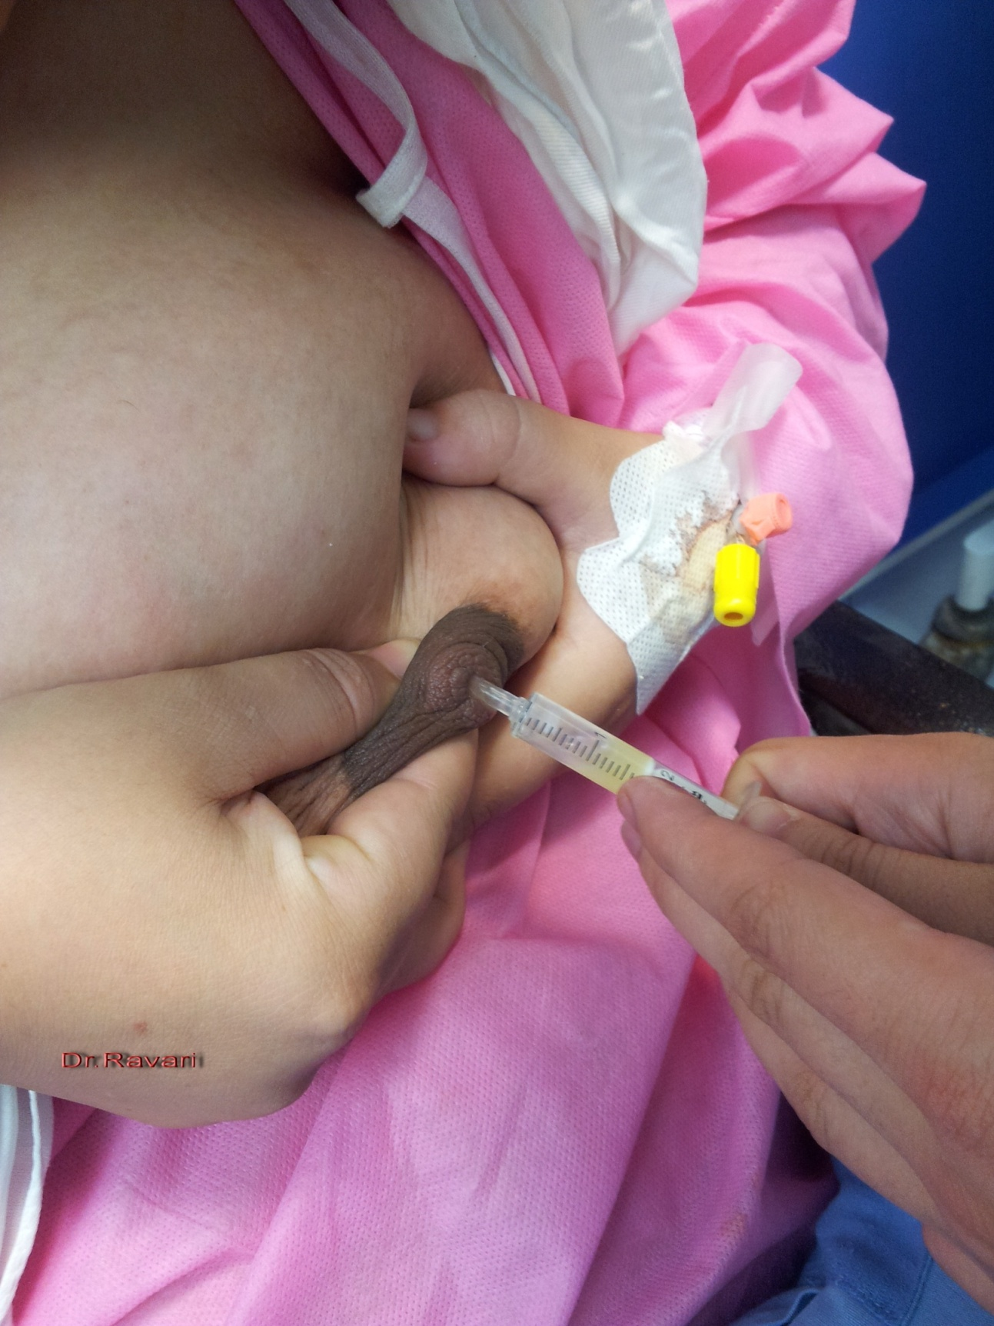
After 10 - 20 compressions, switch to the other breast. . . then back to the first . . . . then back to the second again, etc. Do this despite the presence or abscence of colostrum.
- Remember the newborn baby’s stomach is very small and small amounts every 1-2 hours if what the baby needs
-

Slide 21
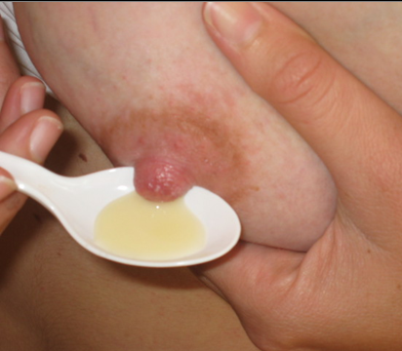
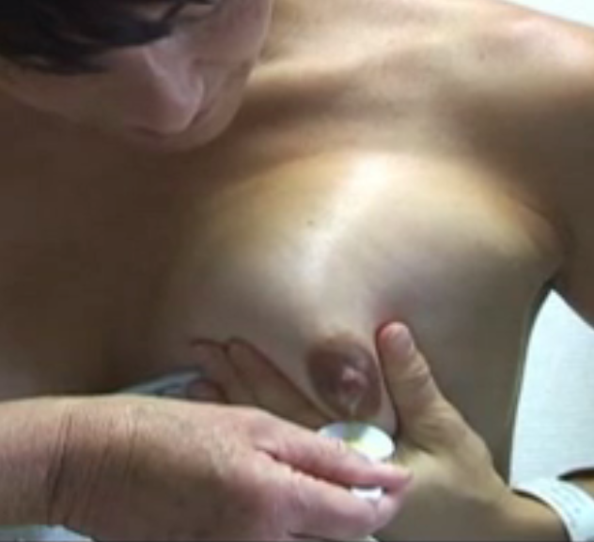
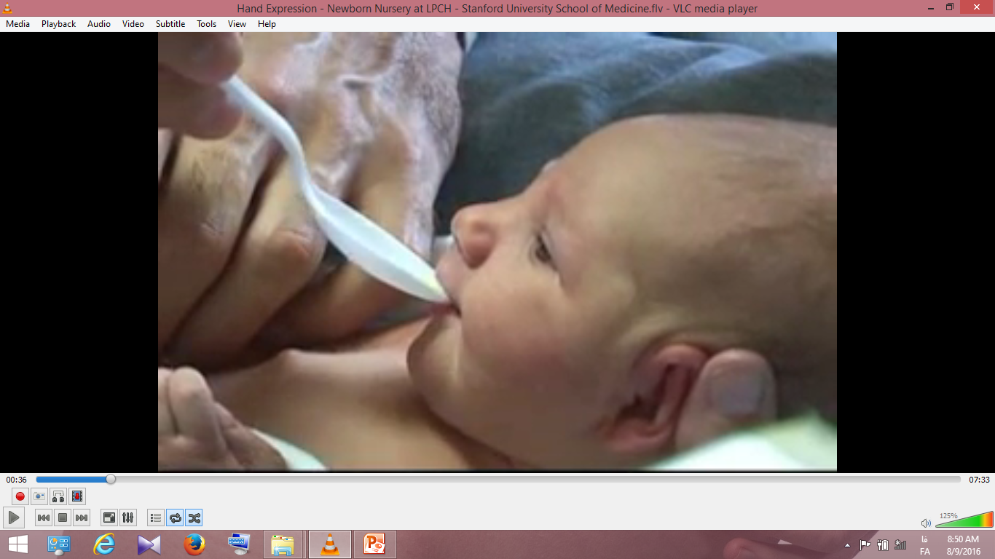
spoon

Slide 22
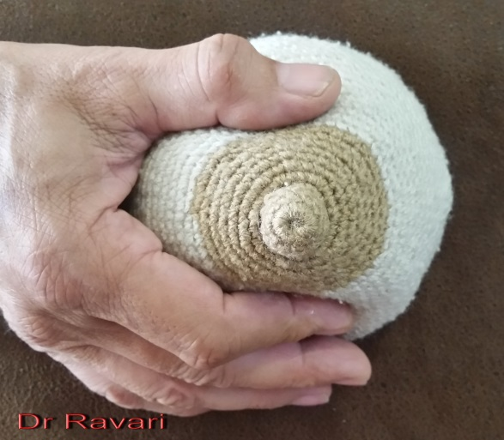
Hand Expression Techniques (1)
Cup the breast with the thumb and forefingers directly opposite each other without touching the nipple or areola.
PUSH straight into the chest wall
ROLL thumb and fingers forward in a rhythmical movement to massage the breast.
REPEAT this action.
ROTATING around the breast.
  Avoid Squeezing the breast
  Avoid Pulling out the nipple and breast
  Avoid Sliding on the breast

Slide 23
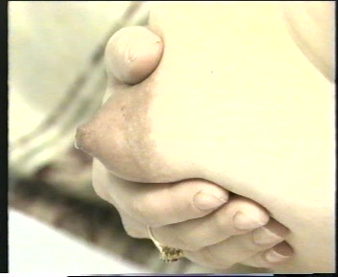
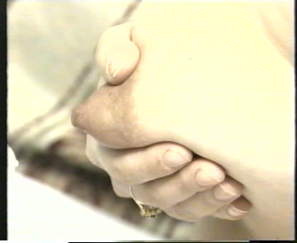
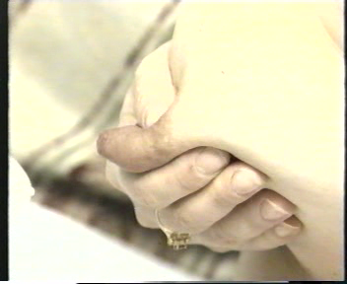
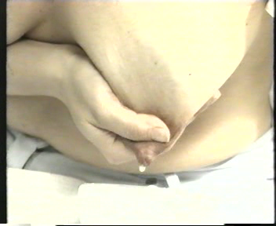
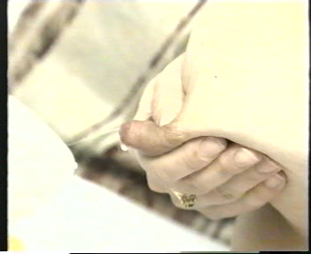
POSITION the thumb and first two fingers
PUSH straight back into the chest
ROLL thumb and fingers forward
Position
Roll

Slide 24
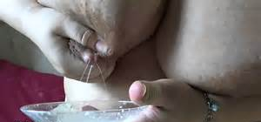
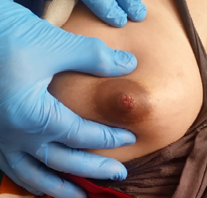
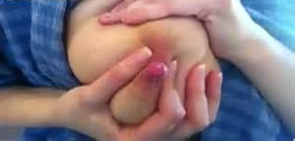
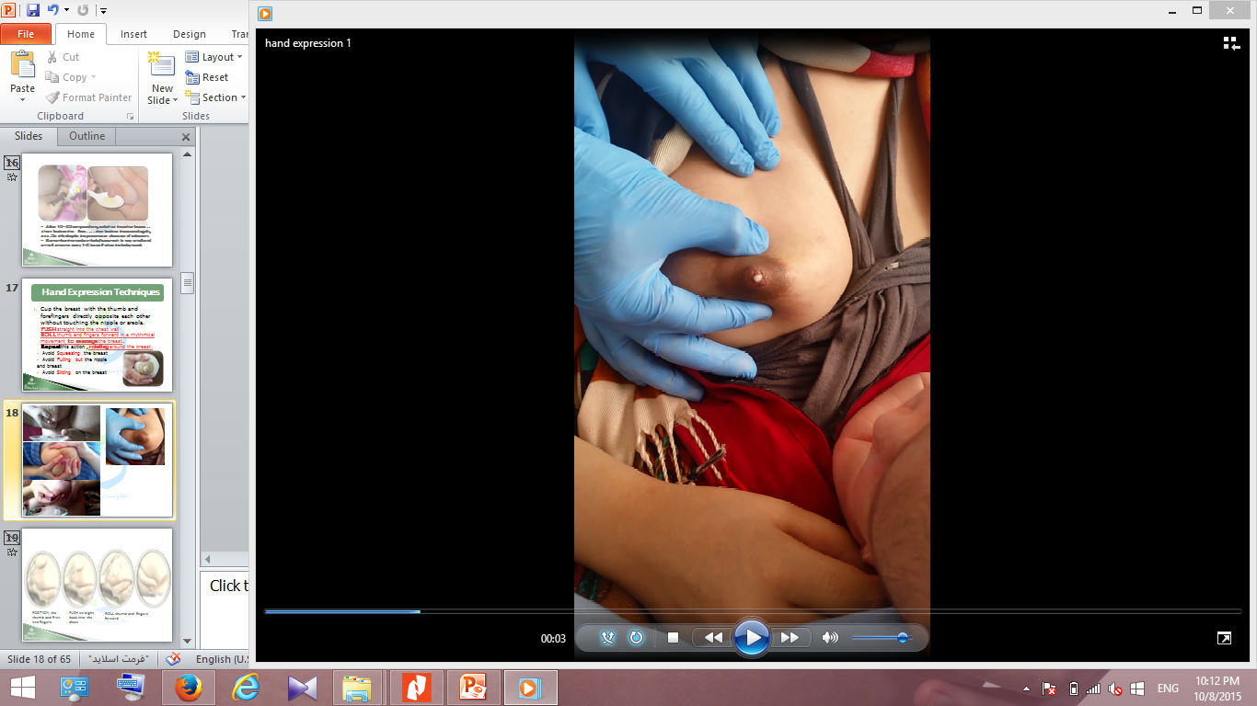
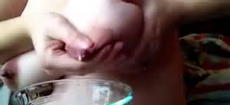

Slide 25
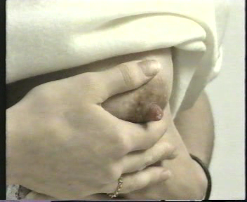
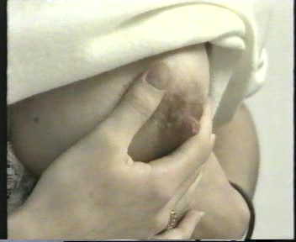
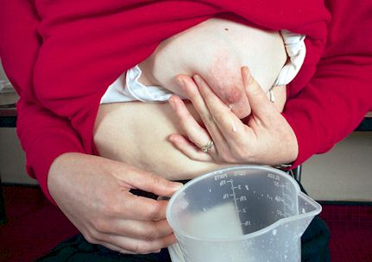
ROTATE the thumb and finger position to milk the other reservoirs
Use both hands on each breast.
The fingers will move from the 12 and 6 o'clock positions,
to 11 and 5 o'clock, 3 and 9 o'clock, 2 and 8 o'clock.
Right Hand
Left Hand
These pictures show hand positions on the Right Breast

Slide 26
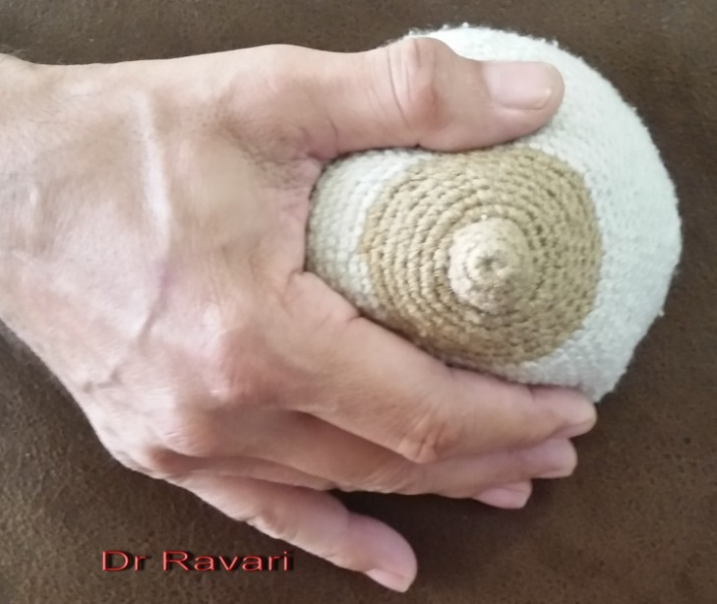
Hand Expression Techniques(2)
Another method Hold the breast that the thumb is on the top and other four finger are cupping the breast from underneath, with the little finger touching the rib. .
To express milk, she will start a wave-like motion from her little finger, pushing gently into the breast followed by the fourth finger, the third, then the index finger while the thumb compresses from above.

Slide 27
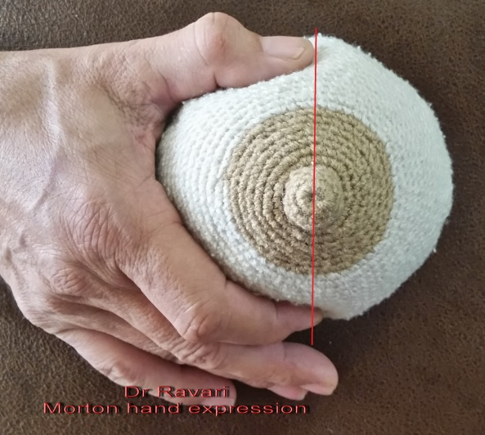
Hand Expression Techniques(3)
Morton's technique (very useful in HOP)
  Step1: sit up and lean slightly forward
  Step2: gentle massage on all areas of both breasts
  Step3: Form a C with thumb and index finger about an inch back from the areola, with the tip of the thumb and finger in a direct line with the nipple
  Step 4:
    press (back),
    compress (together),
    relax (fingers)
  Step5:Alternate breasts frequently
Notes:
Start by washing your hands
■ Apply a warm compress over the nipples and breasts for a few
minutes, allowing dilation of the ducts
■ Perform gentle massage on all areas of both breasts
■ Have the mother sit up and lean slightly forward, if she is able
to do so
■ Form a C with thumb and index fi nger about an inch back from
the areola, with the tip of the thumb and fi nger in a direct line with
the nipple
■ Apply steady pressure into the breast and back toward the chest,
ensuring you are not just tightening the skin with your fi ngers
■ Compress the thumb and index fi nger, bringing them together just
behind the areola
■ Relax the fi ngers to allow the breast to refi ll
■ Alternate breasts frequently, which simulates the suckling and
breathing pauses of a breastfeeding infant
■ You may alternate hands on each breast, as well as orientation of
fi ngers on the breasts, decreasing fatigue
■ Develop a rhythm similar to a nursing baby
It may be helpful to remember press (back), compress (together), relax
(fi ngers) to ensure proper technique
■ It may take a couple of minutes before colostrum fl ows, just like the
initial suckling of the baby while waiting for the milk to let down
■ Perform this technique until colostrum or breast milk is no longer
fl owing with each compression

Slide 28
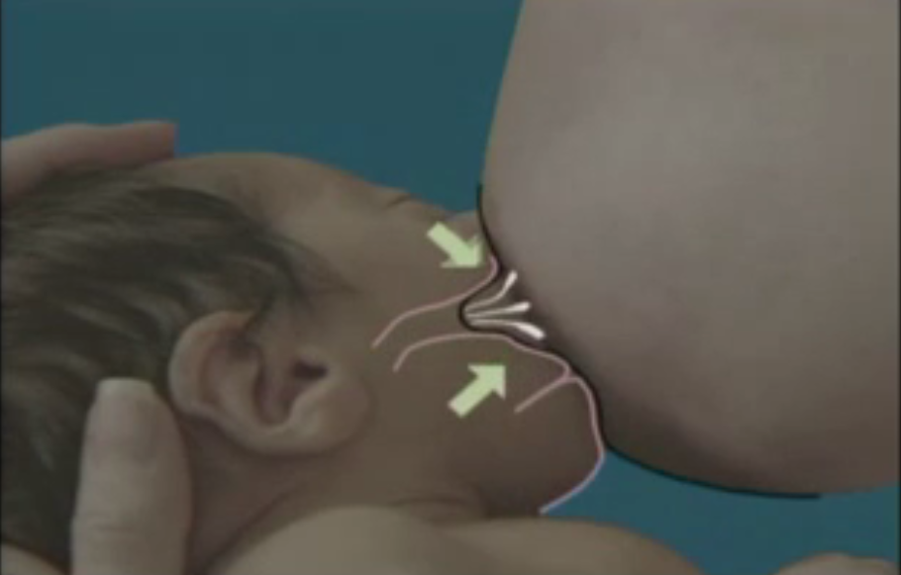
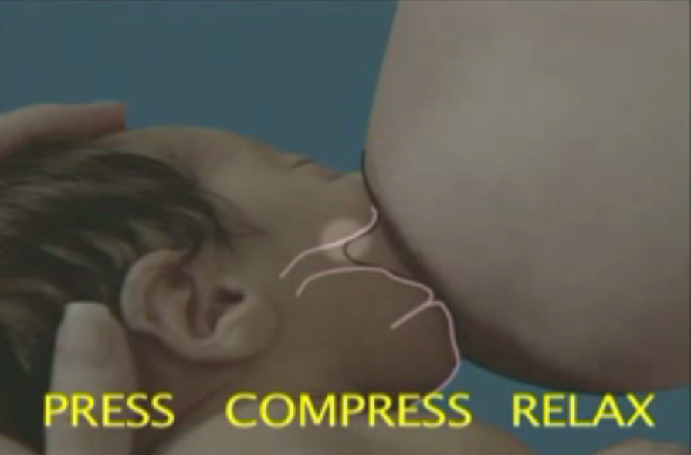
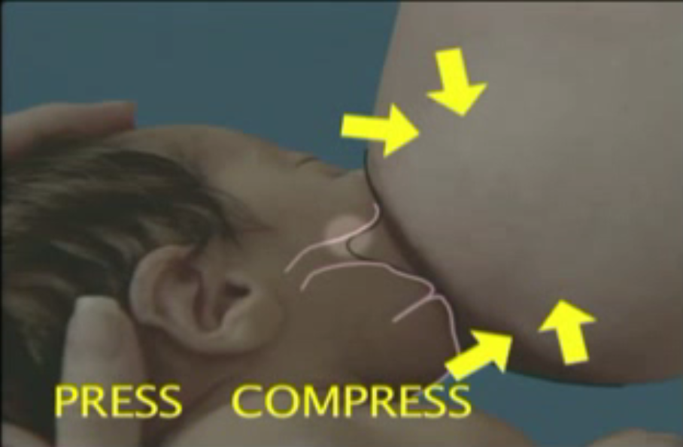
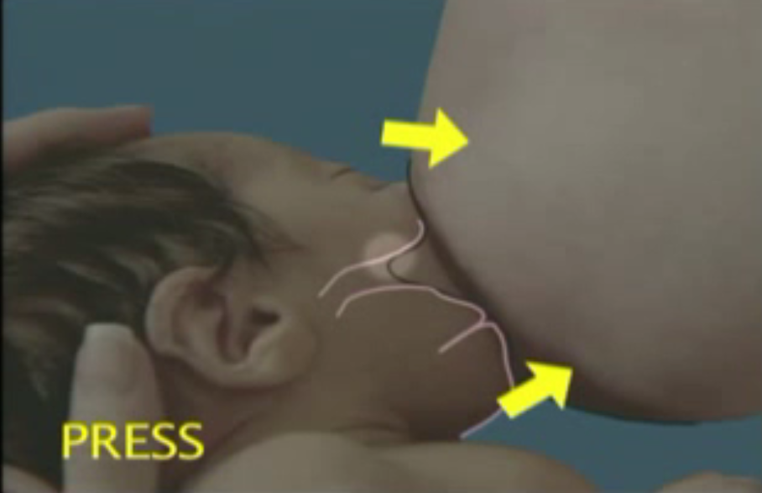
Press ,Compress ,Relax

Slide 29
Timing
(hand expression)
  Express one breast until the flow slows (for at least 3-5 minutes); then express the other side; and then repeat both sides.
  She can use either hand for either breast, and change when they tire.

Slide 30
HOW MILK IS REMOVED
FROM THE BREST?
Infants use suction and a compressive motion to remove milk from the Breast, regular pumps use suction only in a cyclic Pattern.
When milk flow is low, infants suckle faster, When milk flow is high, infants suckle slower.
Average suckling rate is 74 cycles/minute with a range of 36 to 126 cycles/minute.
Negative pressure generated by infant suckling averages 50 to 155 mm Hg with a maximum of 241 mm Hg.
Core Curriculum for Lactation Consultant Practice, International Lactation Consultant Association(ILCA) 2013.
Notes:
-67 Bottle =122 mmg breast

Slide 31
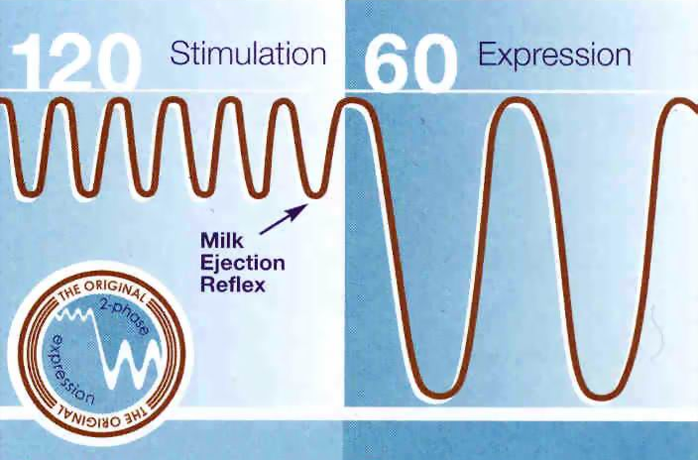
Pumps that allow the mother to adjust the suction and cycling should initially be set on lower suction with faster cycling. Once milk release has occurred, the suction can be increased and cycling decreased to more closely mimic physiological suckling.
Notes:
The rhythm of suction-release is automatically controlled, with a depression adjustment by graduated knob.

Slide 32
Effectively nursing infants can transfer more milk from the breast than the mother who in pumping
Many women find that hand expression is Easier and Faster than using a mechanical breast pump

Slide 33
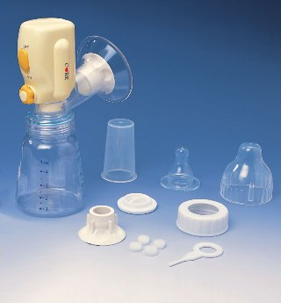
Battery-operated pumps
Require manual release of the vacuum during the pumping cycle…(nipple trauma)
Vacuum takes up to 30 seconds to reach the appropriate level
Time for recovery of the vacuum following release can limit the number of cycle to 6 per minute which is below acceptable ranges.

Slide 34
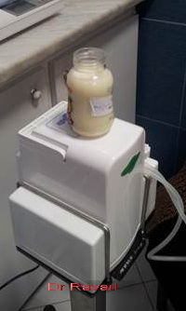
GUIDELINES FOR CHOOSING A BREAST PUMP
AND USING IT CORRECTLY
Proper use of the pump is pivotal in its success or failure..
The pump should be comfortable to use, not causing any pain or discomfort to the mother..Nipple pain during pumping will have a negative effect on supply, (rubbing and constriction of the nipple, blocking the flow of breast milk)
Notes:
امکان سرهم کردن آسان قطعات
داراي ريتم متناوب و قدرت خلاء متعادل(9+_190) نه بيشتر از 250 ميلي متر جيوه و داراي سيستم موتوري و جمع آوري جداگانه
مقاوم بودن قطعات براي ضدعفوني کردن و شستشو
ELECTRIC PUMPS
استفاده آسان و راحت
دوشيدن مقدارشير بيشتر مخصوصاً در روزهاي اول تولد
افزايش مقدار شيروكاهش زمان شيردوشي در فرم دوبل آن
عدم موفقيت در بعضي از مادران
محدوديت مصرف با توجه به منبع انرژي الكتريكي
و عدم دسترسي دائم به آن
قیمت مناسب و ارائه خدمات و......

Slide 35

There are Two main types of double electric breast pumps available on the market
The majority of manufacturers make breast pumps that require a piston to create a vacuum, causing the nipple to be moved in and out of a barrel ….
  The pump piece, or flange, that goes over the mother’s nipple may or may not come in different sizes.
  A pump that enables interchangeable flange sizes in several increments is ideal when using this piston-type pump
Notes:
امکان سرهم کردن آسان قطعات
داراي ريتم متناوب و قدرت خلاء متعادل(9+_190) نه بيشتر از 250 ميلي متر جيوه و داراي سيستم موتوري و جمع آوري جداگانه
مقاوم بودن قطعات براي ضدعفوني کردن و شستشو
قیمت مناسب و ارائه خدمات و......

Slide 36
GUIDELINES FOR CHOOSING A BREAST PUMP
AND USING IT CORRECTLY
the size of the flange should be determined in accordance with the diameter of the mother’s nipple at the height of expansion during pumping.
Hard- or Soft-Rimmed Flanges
Vacuum Pressure
  Although some women are able to tolerate the preprogrammed vacuum pressure without any discomfort, others may need to adjust the pressure up or down to their own comfort, depending on the elasticity of their nipple/areolar complex.
Notes:
If using a type of pump that works
by moving the nipple in and out of the barrel of a fl ange, the size of
the fl ange should be determined in accordance with the diameter of
the mother’s nipple at the height of expansion during pumping. This
means that just because the nipple starts out being one size at the
beginning of the pumping session, it will not necessarily be the same
size after 10 or 15 minutes of pumping. In addition, consideration
for maternal fl uid shifts, as well as differences in individual nipple
sizes in the same woman, need to be taken into account.
امکان سرهم کردن آسان قطعات
داراي ريتم متناوب و قدرت خلاء متعادل(9+_190) نه بيشتر از 250 ميلي متر جيوه و داراي سيستم موتوري و جمع آوري جداگانه
مقاوم بودن قطعات براي ضدعفوني کردن و شستشو
قیمت مناسب و ارائه خدمات و......

Slide 37
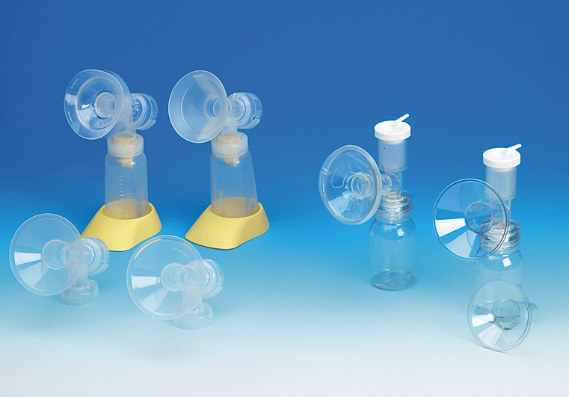
The size and shape of flange is important for successful milk expression

Slide 38
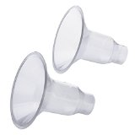
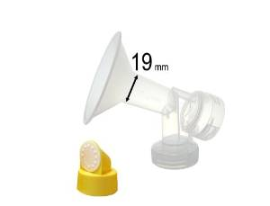
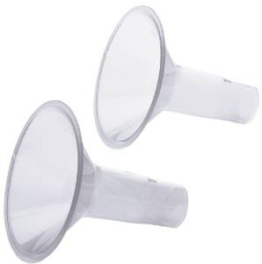
Hard-rimmed flange

Slide 39
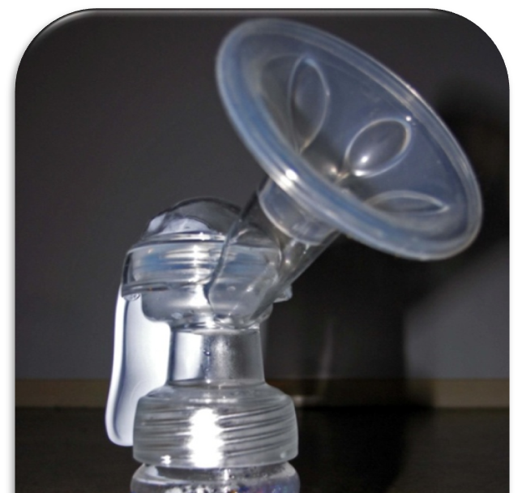
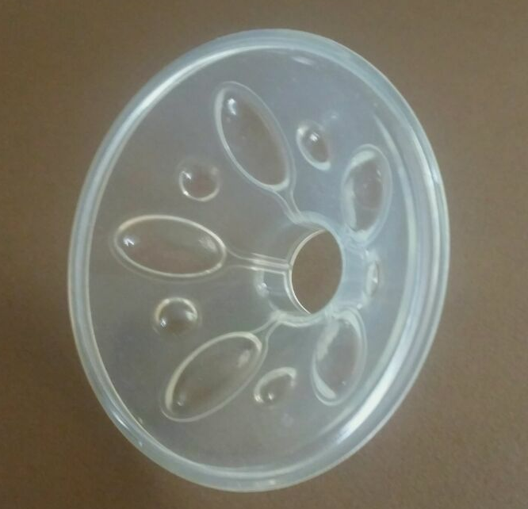
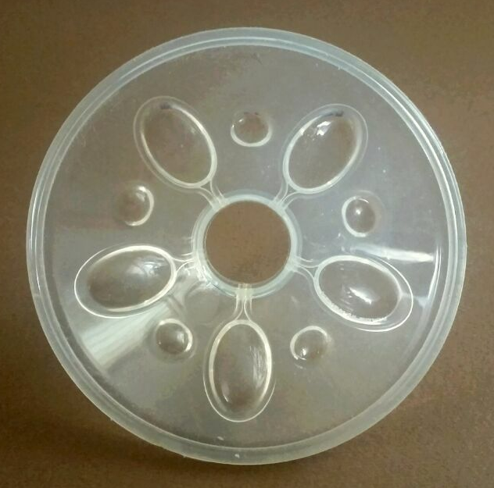
Soft-rimmed flanges
Many women state that they find
the soft-rimmed fl anges more comfortable

Slide 40


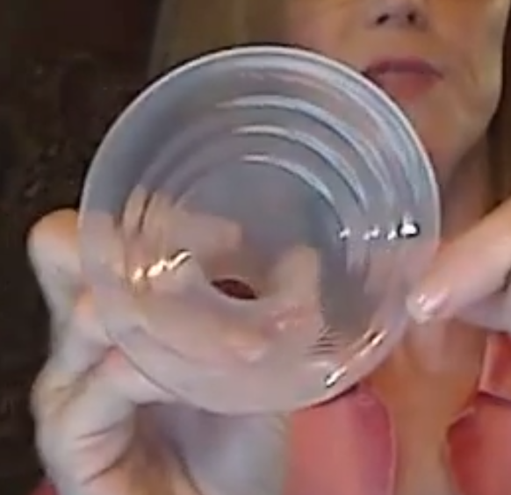
SUPPER SHEILD

Slide 41
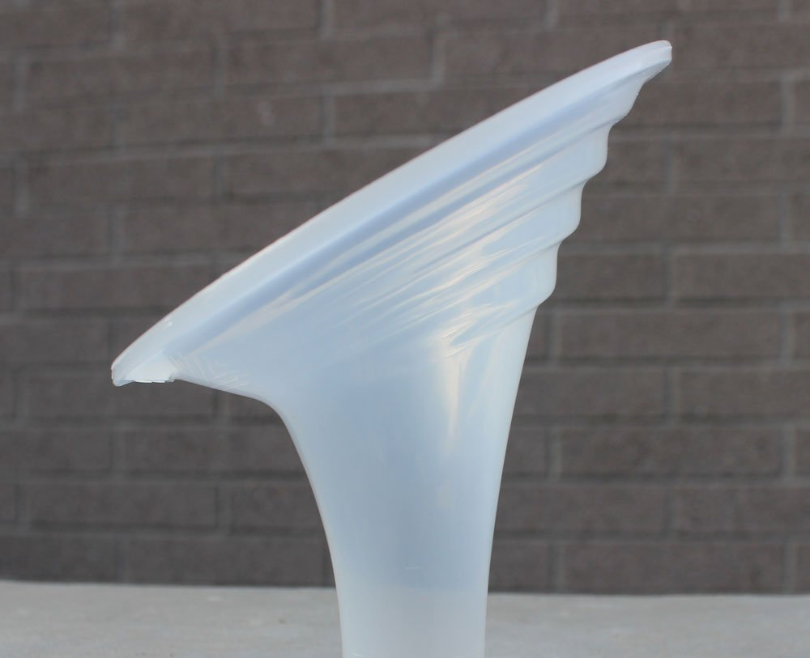
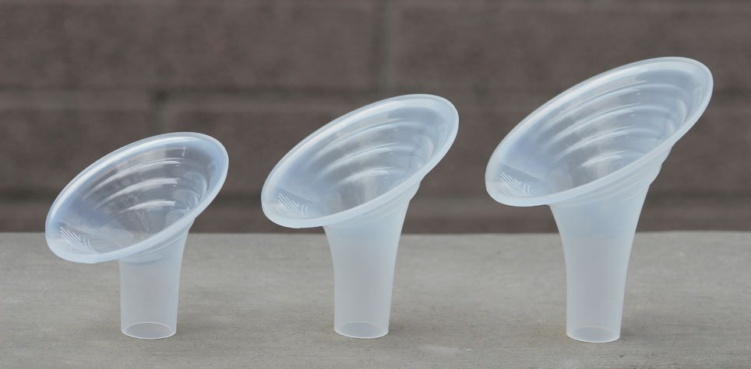
SUPPER SHEILD

Slide 42
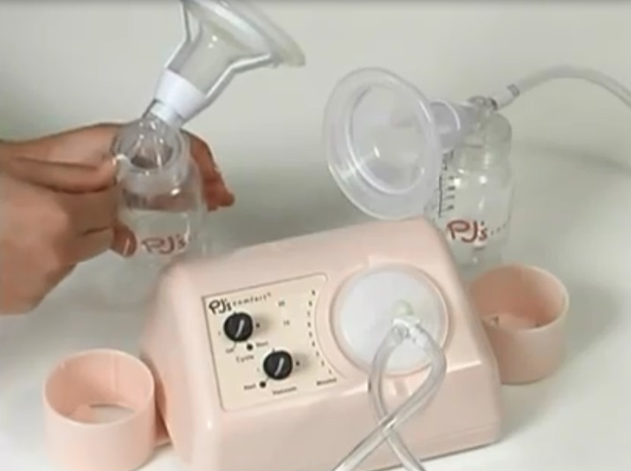
There are Two main types of double electric breast pumps available on the market
The other type of breast pump, specific only to the Limerick pump, does not depend on vacuum alone. It combines vacuum and compression, much like that of a suckling baby, To remove breast milk from the breast.
  The flange comes in one size only and allows for any size nipples to be comfortably compressed instead of pulling them into a tunnel.
  The vacuum pressures may be decreased more than the other types of pumps but continue to be enough for effective breast milk removal.
Notes:
امکان سرهم کردن آسان قطعات
داراي ريتم متناوب و قدرت خلاء متعادل(9+_190) نه بيشتر از 250 ميلي متر جيوه و داراي سيستم موتوري و جمع آوري جداگانه
مقاوم بودن قطعات براي ضدعفوني کردن و شستشو
قیمت مناسب و ارائه خدمات و......

Slide 43
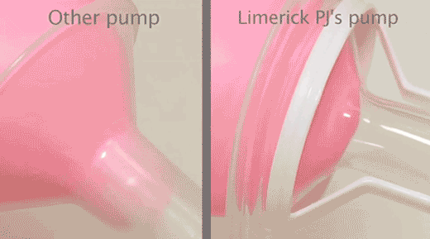
Pumps Operation
Breast Pump Instruction PJ's Comfort by Limerick

Slide 44
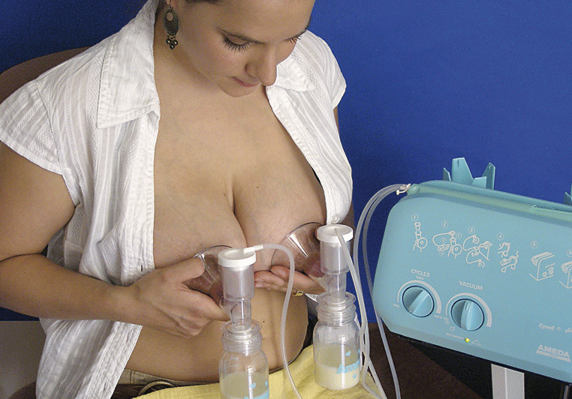
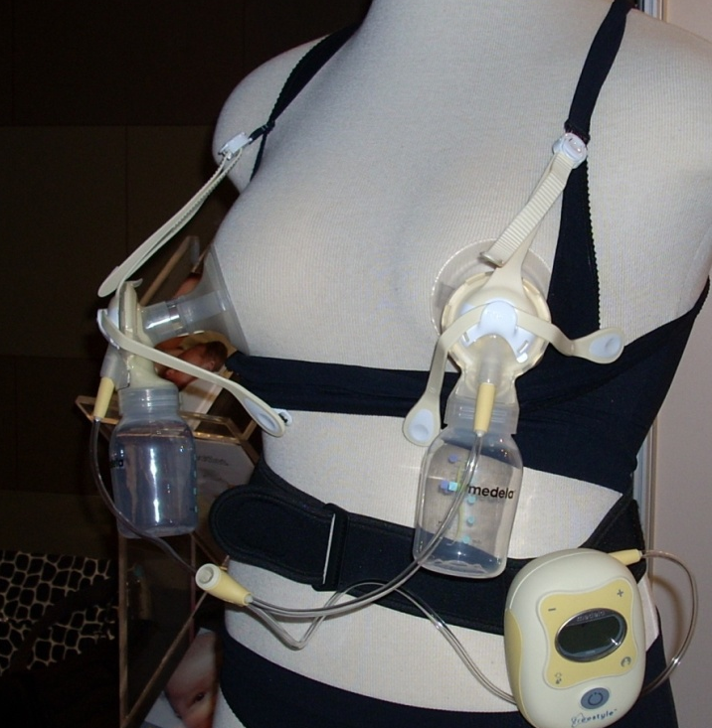
Double electric pump (simultaneous pumping)
Use when time is limited in order to increase a milk supply, as well as for prematurity, maternal or infant illness, or other special situations More milk,
Did better in stimulating prolactin levels than did battery or manual pumps, or hand expression, when only one breast was stimulated at a time
Most mothers prefer double,
Less time involved than single,
  10–15 minutes for double pump,
  20–30 minutes for single pump.

Slide 45
Massage During Pumping
Cupping the breast also allows for the mother to massage her breasts during pumping, which has proven to
  increase milk production,
  increases ejection of milk already in the breast,
  ensuring more complete emptying of the breast and
  can possibly increase the fat content of the milk

Slide 46
Combining breast expression and massage with electric pumping may increase milk output..Without increasing frequency or duration of pumping, milk output increased over several weeks from an average of 591 ml/day to a post instruction output of 862 ml/day.

Slide 47
Expression with massage
Sequential expression without massage: 51 grams
Sequential expression with massage: 79 grams
Simultaneous pumping without massage: 88 grams
Simultaneous pumping with massage: 125 grams
The massage occurred before pumping, but theoretically, addi-
tional massage during pumping could even have higher yields.
following milk expression amounts on 36 women with preterm infants in a NICU in the
United Kingdom …

Slide 48
(HOP) hands-on pumping
Combine
  Hand expression with
  Electric breast pump expression
demonstrated an average milk production between 900 and 1000 mL /day by day 8, compared with typical milk production of 500 to 600 mL average per day using only an electric pump.. expressed milk volumes can be increased by 48% by (HOP)
.

Slide 49


Steps for Hands-On Pumping
Massage both breasts
Pump both breasts simultaneously
Both massage and compression during milk expression
Stop pumping once milk flow is reduced to drops
Repeat massage
  Single pump and/or hand express
    Alternating breasts for several minutes at a time
Continue until breasts feel empty

